Slide 1
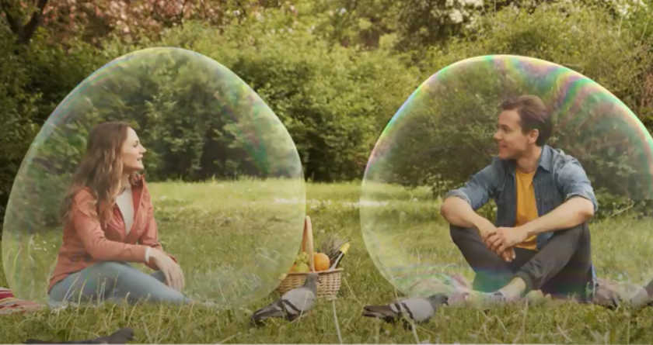
Bubbles
October 2020
COVID Bubbles
Campaign Information Pack

Slide 2
Making invisible protection visible.
The HSE COVID Bubbles campaign creates a visual reminder of the protection we can share when we follow public health actions, and how easy it can be the lost. The bubble idea makes the invisible visible.
There is strong evidence to show that mass media campaigns can help to change behaviour. Insights from social science suggest that encouraging a shared sense of purpose, promoting preventative behaviours as a social norm, ensuring that people know where they can go for trusted information, and highlighting that we all benefit from each other’s actions to prevent the spread of infection are central to the COVID-19 response.
For some time, cases have been rising, especially in younger age groups and today, our country enters a new phase of level 5 restrictions. It’s now more important than even that we understand how protective measures can keep us all safe and slow the spread of the virus.
We are also asking for support this week from well-known people and social media ambassadors who have strong followings on Instagram and TikTok. We know that COVID is the problem and that we are all the answer - so we’re asking for everyone’s help to reinforce the public health messaging, by taking part in a social relay of actions they are taking to help fight COVID. You can join in this relay, sharing what you do each day to help protect yourself and others – use the #HoldFirm to take part or share.

Slide 3
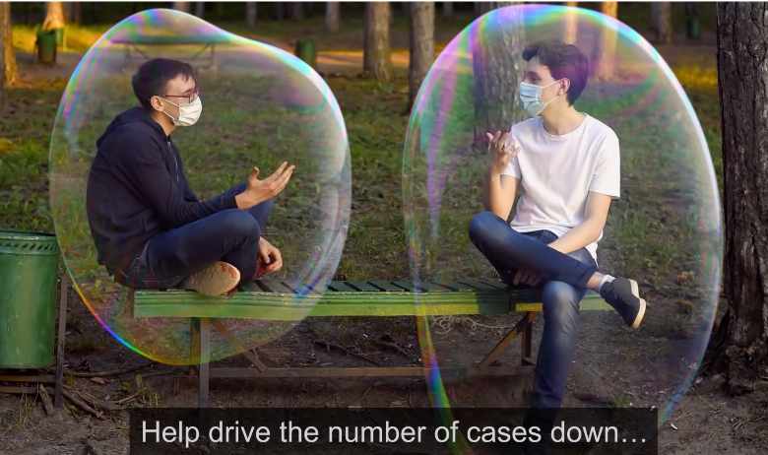
COVID Bubbles -Script
When you keep your distance, no matter how awkward it feels, you’re protecting yourself and those around you from the spread of COVID-19.
But when you drop your guard,
When groups get together,
When you shake hands or hug someone you love,
When you step forward instead of taking a step back,
You could become exposed to the virus and so could the people around you.
Help drive the number of cases down.
Keep your guard up.
Watch the ad on YouTube

Slide 4
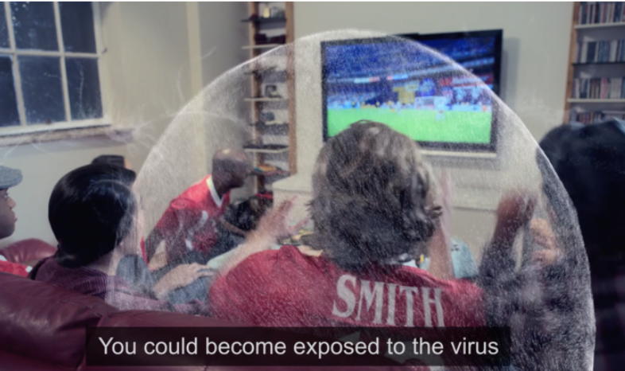
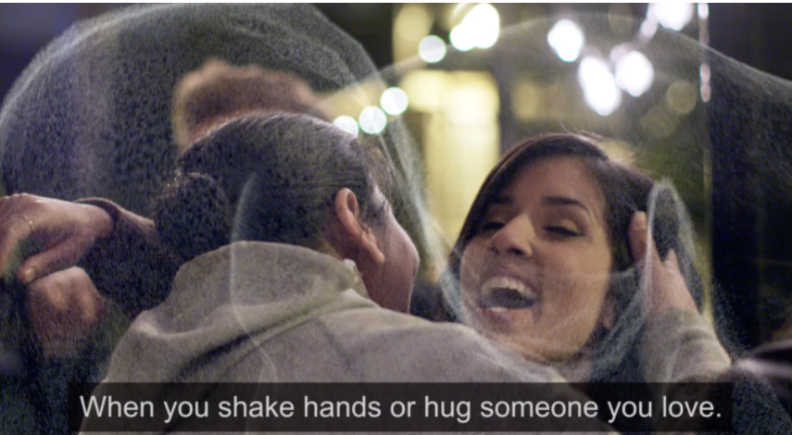
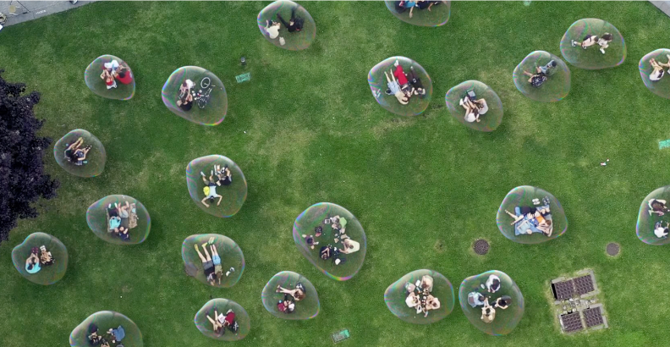
Advertising details
Watch the ad on YouTube
Media will include:
Social Media – Facebook, Twitter, Instagram, TikTok
TV and video on demand
Digital Formats including YouTube and Twitch
Spotify
Digital Display

Slide 5
Social media
We welcome your support in sharing the updated campaign messages, and social media is the easiest way for you to do that using #HoldFirm to connect. Here are some sample posts and images – or you can share the posts directly from the HSE’s accounts on:
Facebook HSEIreland Instagram @Irishhealthservice Twitter @hselive TikTok https://www.tiktok.com/@hselive
Social Media Suggested Content
Message | URL Links
When we keep our distance, we’re protecting ourselves and those around us from the spread of COVID-19. If we drop our guard we could become exposed to the virus and so could the people around us. Let's keep our guard up. #StaySafe #HoldFirm | https://www2.hse.ie/coronavirus
When we keep our distance, no matter how awkward it feels, we’re keeping our guard up against the spread of #COVID19. Keep your guard up, and help to keep ourselves and our loved ones safe #HoldFirm | https://www2.hse.ie/coronavirus
When you keep your distance, you are protecting yourself and others from #COVID19. But when you drop your guard, you could become exposed to the virus and so could the people around you. Help us drive case numbers down – keep your guard up #HoldFirm | https://www2.hse.ie/coronavirus

Slide 6
Thank you to all our partners and supporters for helping to share our advice and information on COVID-19.
For partner requests, please email partner.pack@hse.ie
For media enquiries, please email
press@hse.ie
For social media and website questions, please contact:
Digital@hse.ie
www.hse.ie/communications

