Slide 1
Living with COVID
6 August 2020
Campaign Information Pack

Slide 2
Thanks to the care taken by everyone over the last few difficult months, the number of people with COVID-19 has reduced in Ireland. But, as we continue to reopen services and communities, we need to hold firm and keep up the important actions that keep us safe.
We all know the messages, because we have heard them so often – perhaps sometimes to the extent that they are harder to value and remember to do. As we start to see small increases in cases, we want to reinforce the power of:
Cleaning our hands
Keeping our distance – and - where we can’t do this
Wearing face coverings
Covering our coughs and sneezes
Using the COVID Tracker app
More of us are going to work and socialising, commuting and eating out. Our public health advice is asking people to avoid crowds, especially indoors, and limit the number of people we’re meeting.
While we are all working and living with COVID, we can also take action to keep ourselves and others safer.

Slide 3
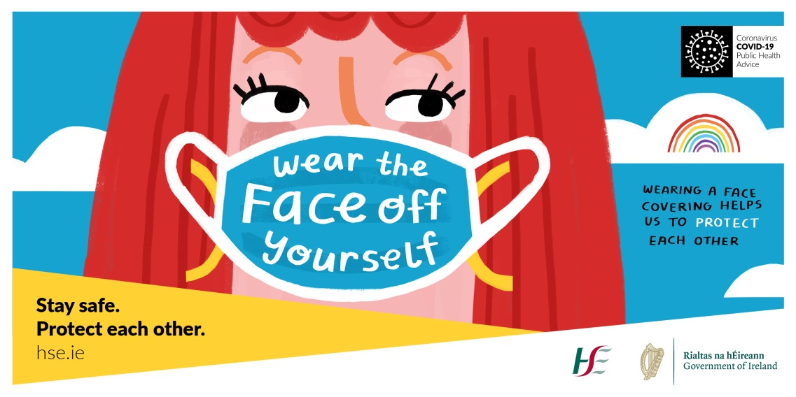
A new look
To find a new way to share our good advice, we have worked with our public health team, agency TBWA Dublin and well known illustrator Fatti Burke to develop the messages and fresh new look for this phase of the COVID campaign.

Slide 4
Advertising details
The HSE is launching the refreshed Living with COVID campaign starting from Thursday 6 August, including:
Out-of-home advertising in urban areas, and in commuter locations and retail locations.
Radio on all stations in Ireland and on Spotify. You can listen to and download the radio ad here on Soundcloud.
Here’s the radio script: Sometimes you might forget, but every one of us is still at risk from Covid-19. But, every time we do the right thing, we’re protecting ourselves and the people around us.
So next time you meet up, just take a step back. Let’s all keep cleaning those hands, and wear a face covering when you’re shopping or on public transport. If you cough or sneeze - cover it or have a tissue handy. And download the COVID tracker app, to be one in more than a million.
Because COVID-19 is still a problem… and we’re all the answer.’
Social media posts on all HSE accounts and platforms.
Television and on video on demand players online will be live later in August.

Slide 5
Social media posts
We welcome your support in sharing the updated campaign messages, and social media is the easiest way for you to do that.
Here are some sample posts and images – you can share the posts directly from the HSE’s accounts on:
Facebook HSEIreland Instagram @Irishhealthservice Twitter @hselive LinkedIn
Social Media Suggested Content
Key message | URL Links
Clean hands stop the spread of COVID-19 – just wash and go.⁣⁣ #COVID19 #StaySafe #HoldFirm | https://bit.ly/2XvDPXf
Wearing a face covering helps stop the spread of COVID-19, especially from people who don’t know they have it. If you can wear one, please do. #COVID19 #StaySafe #HoldFirm | https://bit.ly/2XvDPXf
Take one step further to keep each other safe. #COVID19 #StaySafe #HoldFirm | https://bit.ly/2XvDPXf

Slide 6
Social media images

Slide 7
Thank you to all our partners and supporters for helping to share our advice and information on COVID-19.
For partner requests, please email partnerpack@hse.ie
For media enquiries, please email
press@hse.ie
For social media and website questions, please contact:
Digital@hse.ie
www.hse.ie/communications

